Slide 1
Progress Review
16019243 – N. Appleton
Notes:
Hard to fit all in in 15 mins, will only be a brief overview

Slide 2
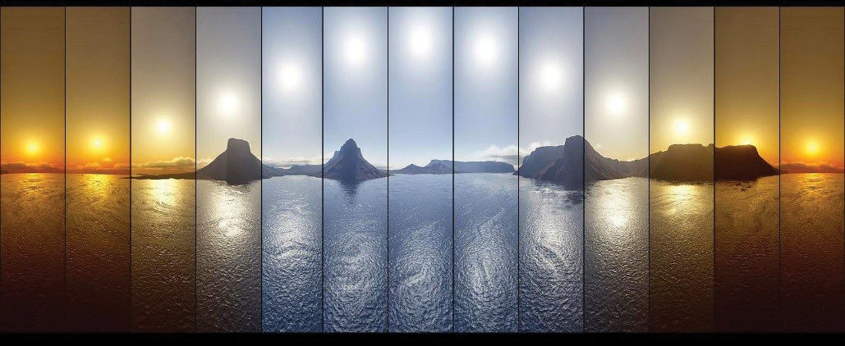
Background
Light Affects:
Sleep
Attentiveness
Cancer
“Light affect our sleep more powerfully than any drug”
(Czeisler, 2013)
Bipolar disorder
seasonal affective disorder
type 2 diabetes
We thrive best under more naturally lit environments
This research is completely neglected in the built environment (Grose, 2014)
There are no existing, economical solutions
Can a modular natural-lighting solution be economically produced?
Notes:
Lots of literature
No affordable consumer solutions
Only for offices/warehouses
Not complex, but filling a need

Slide 3
Methods
Develop Requirements
Determine how the device should function
What would make a successful device?
Develop Hardware & Simulator
Create PCBs that will fulfil the requirements
Produce a simulator that can synthesis spectral outputs
Calibrate Simulator
Calibrate synthesised outputs
Use measured outputs from the device
Determine Desired Spectra
Calculate and produce spectra to be used on the device
Ensure as close to solar outputs as possible
Test Desired Spectra
Use spectrometer to test the accuracy of the device outputs
Using automation suite to extract spectral data from images
Analyse effectiveness of device
Test device against requirements
Use outputs to determine sleep effects (Lucas, 2014)
Notes:
Vojtech
Melanopic lux

Slide 4
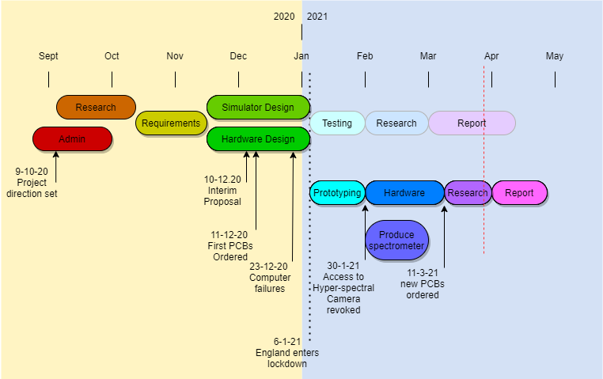
timeline
Notes:
Kanban style agile workflow using clickup
Due to the pandemic, lots of strategies have been employed:
adaptable gantt charts,
emphasis on simulator,
alternative study questions

Slide 5
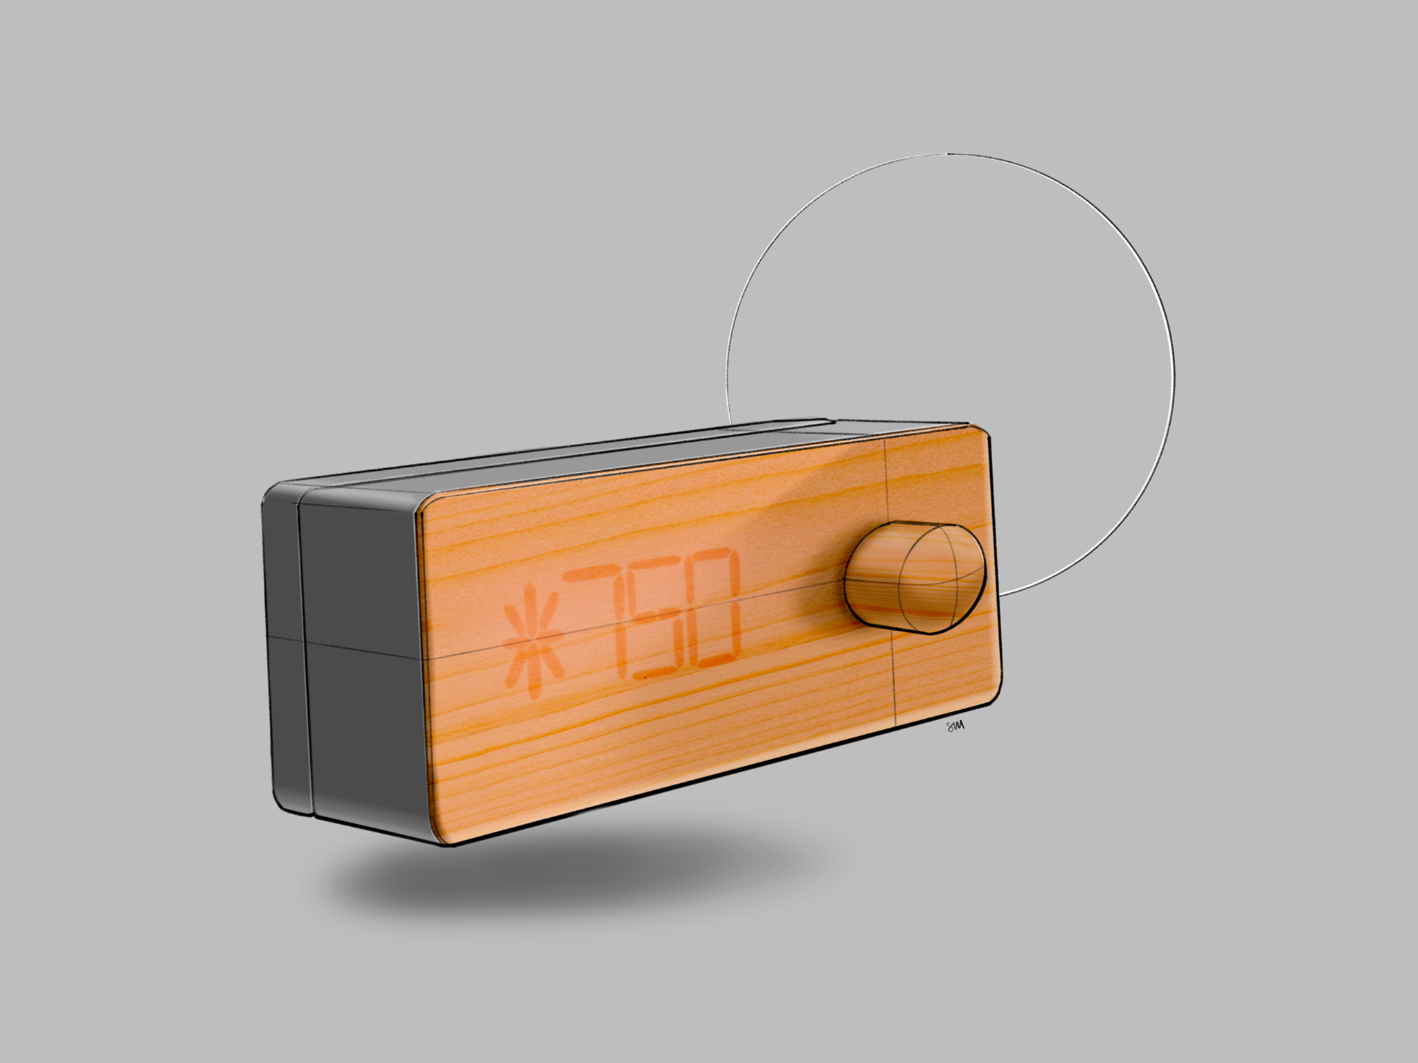
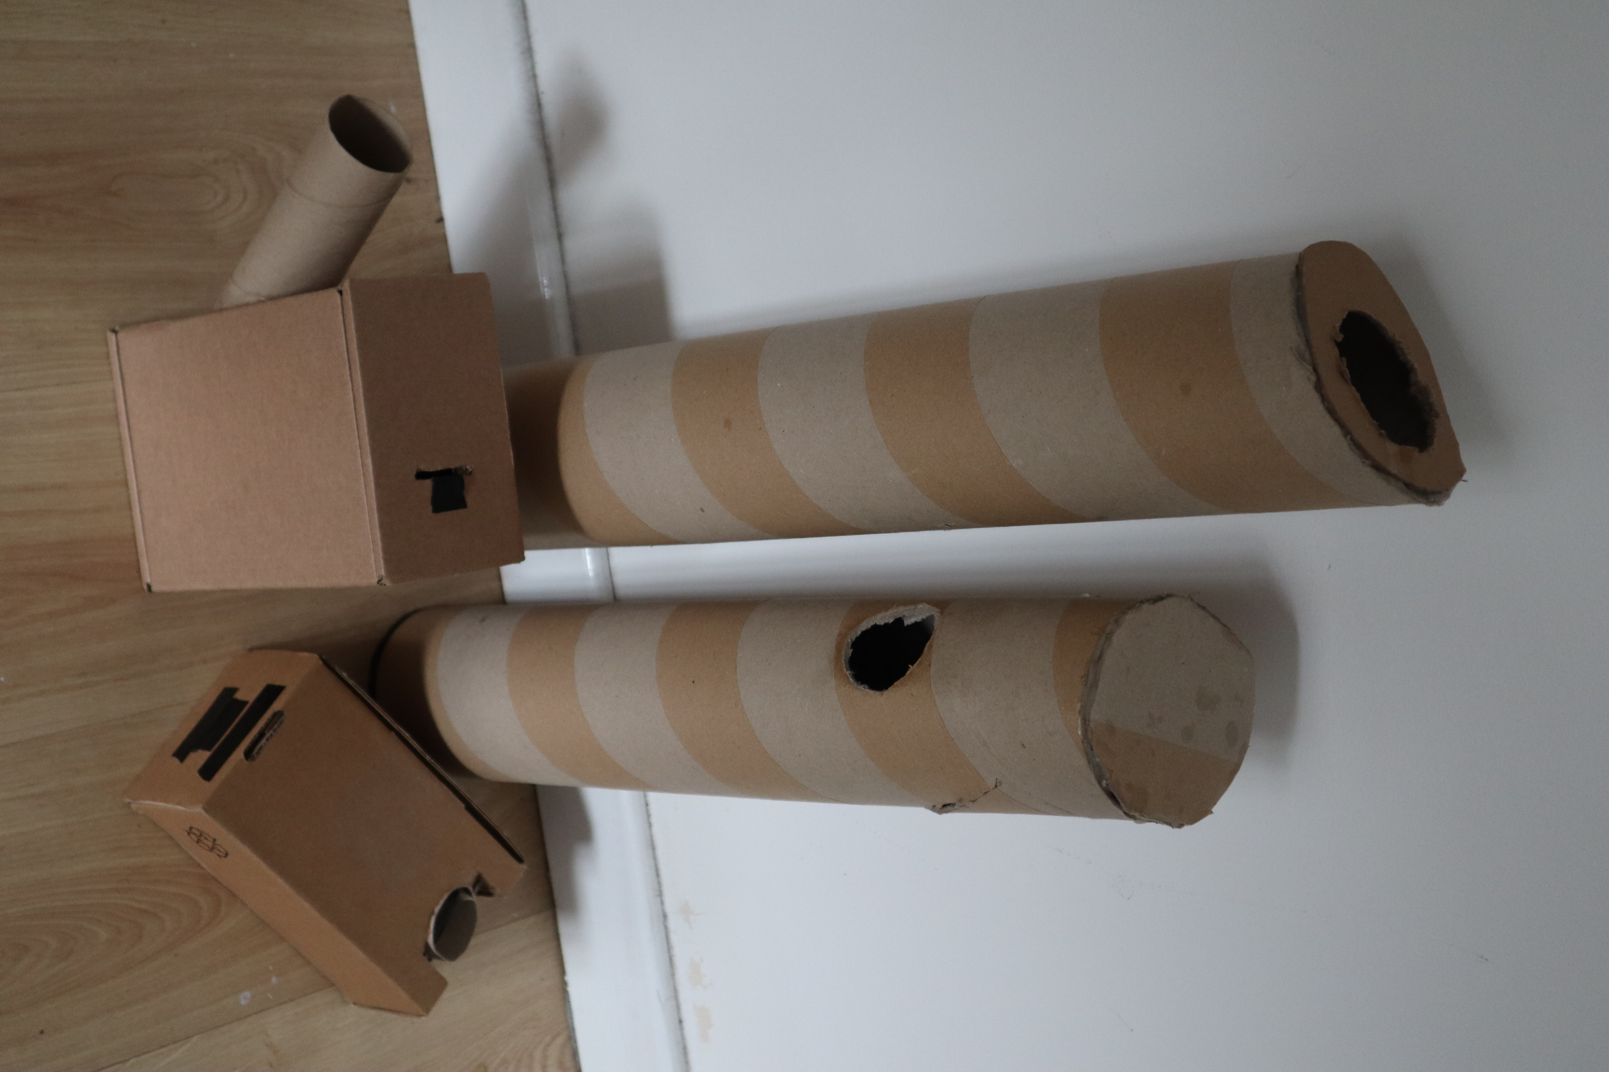
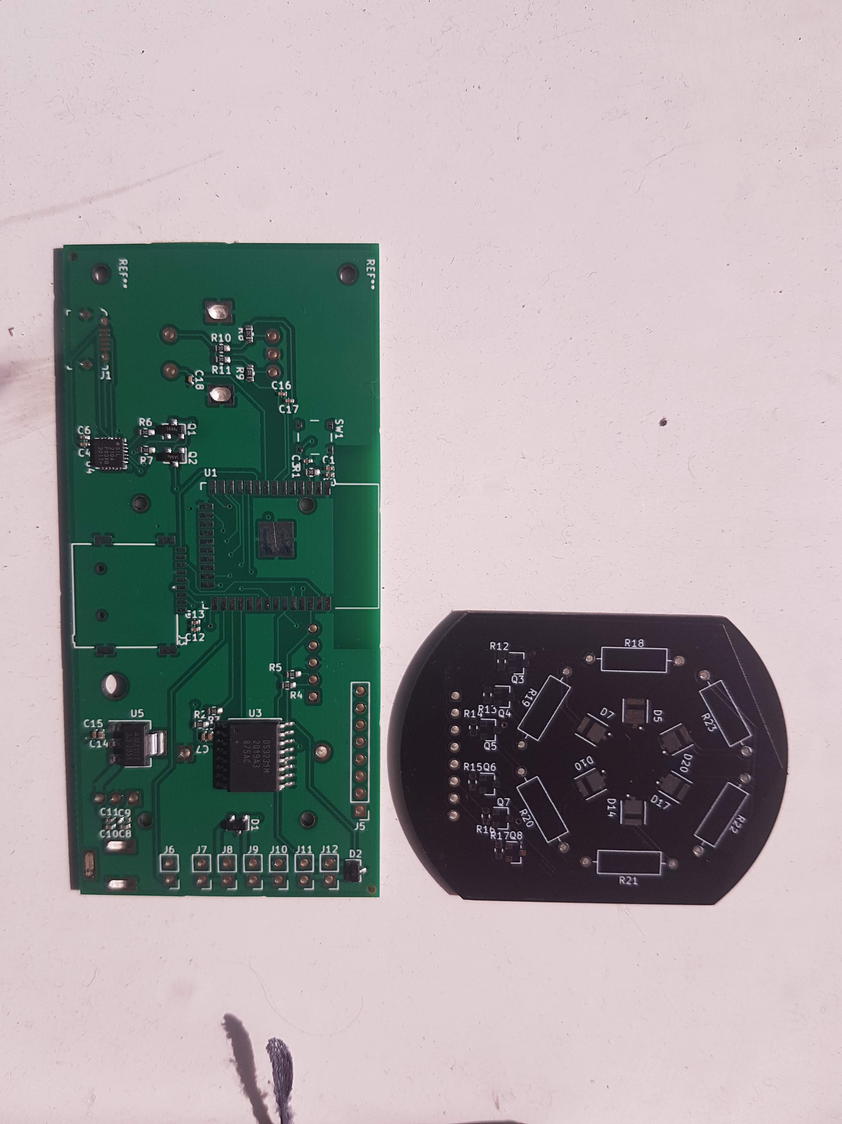
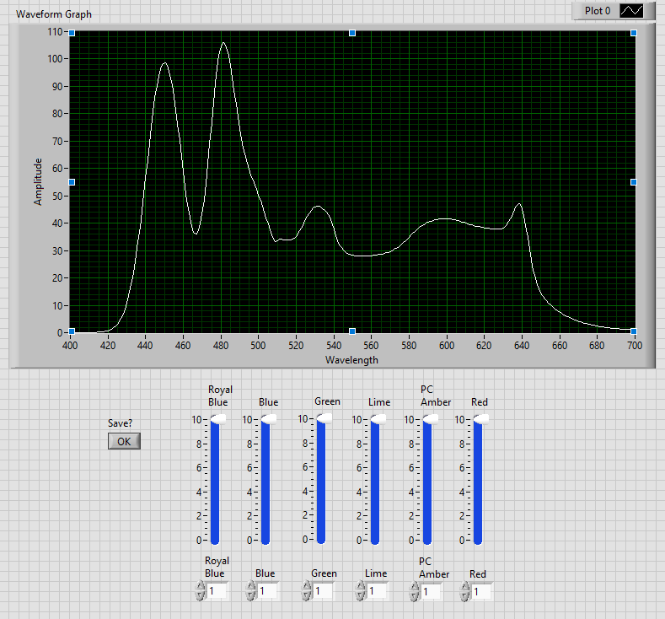
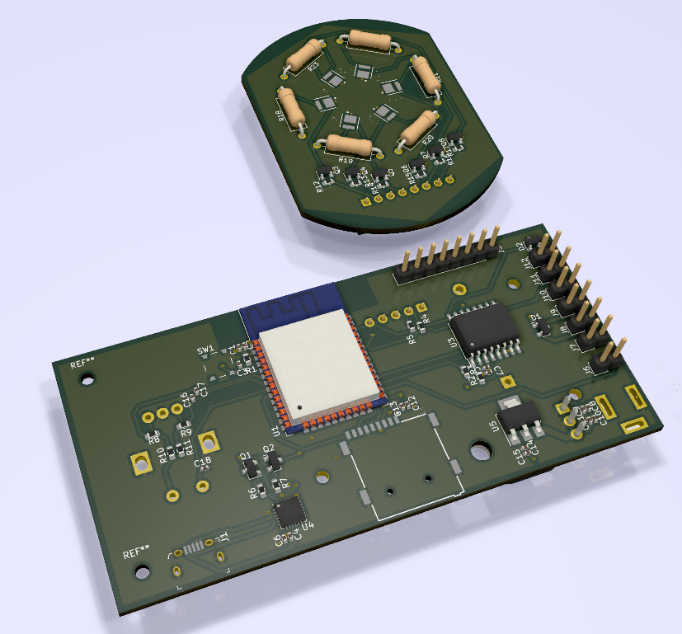
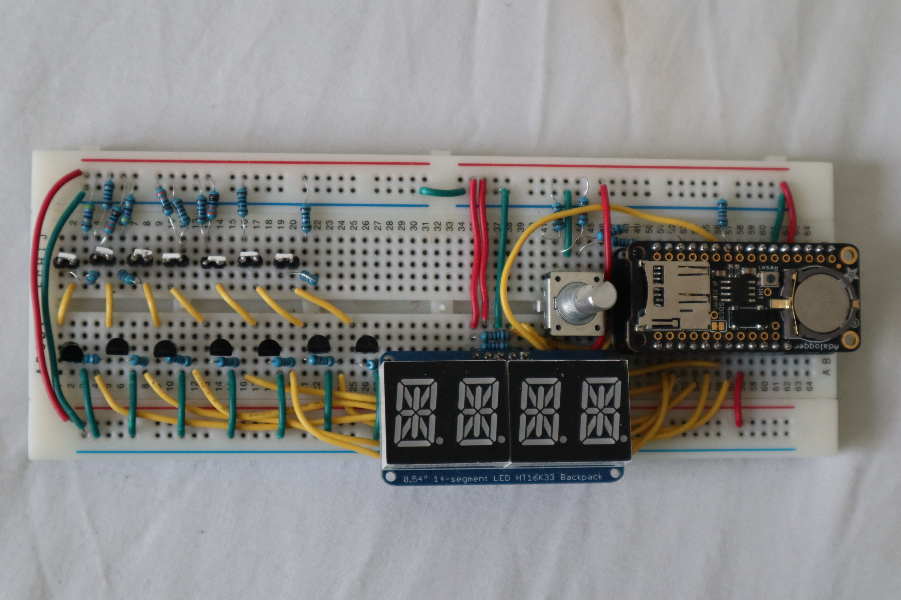
Outputs
Simulator
Spectrometers
PCB
Prototype
Notes:
Things produced
Creative results

Slide 6
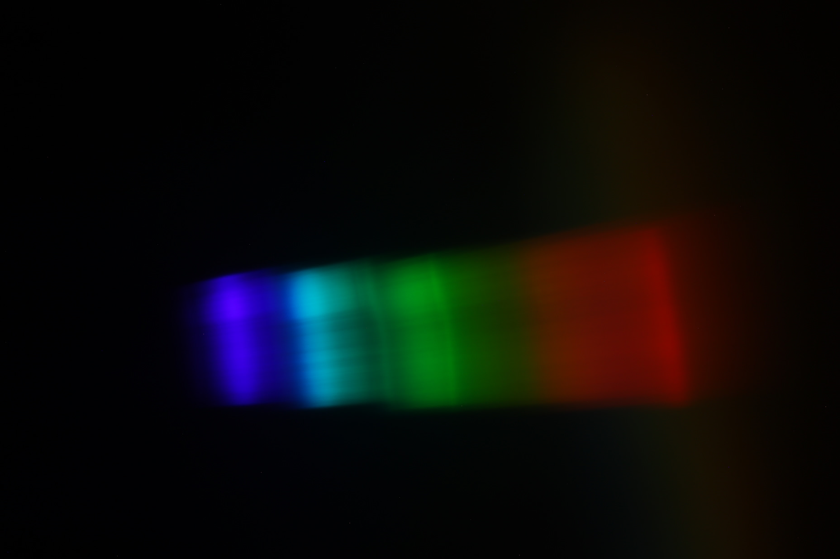
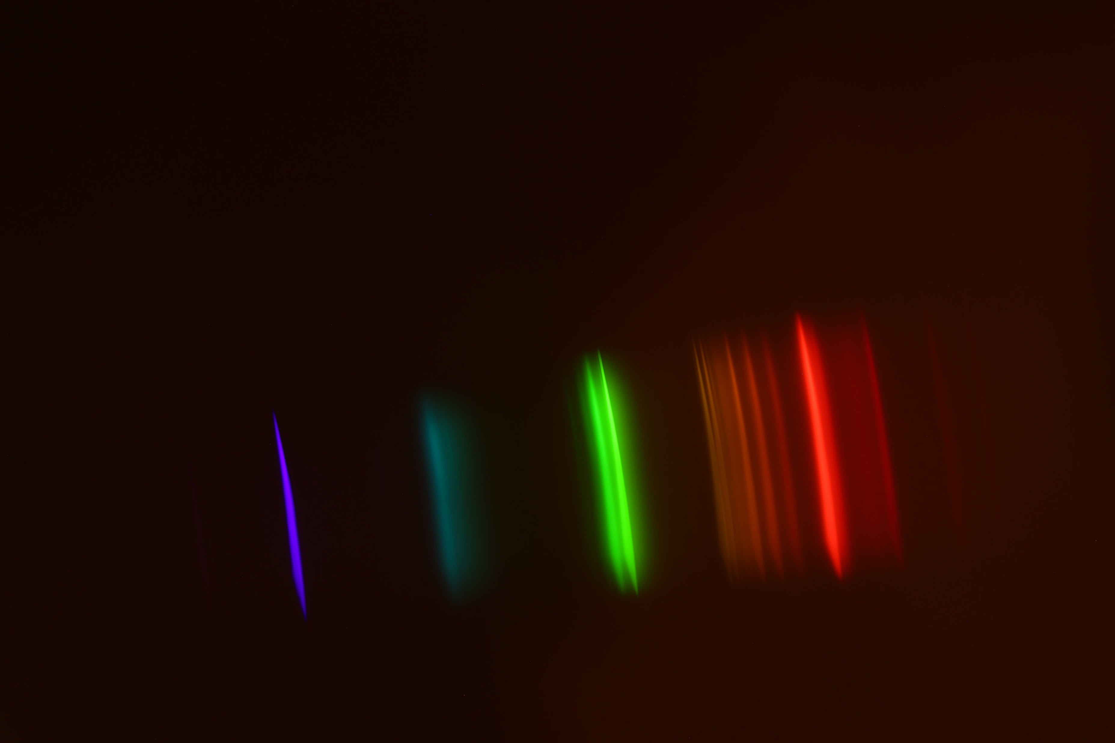
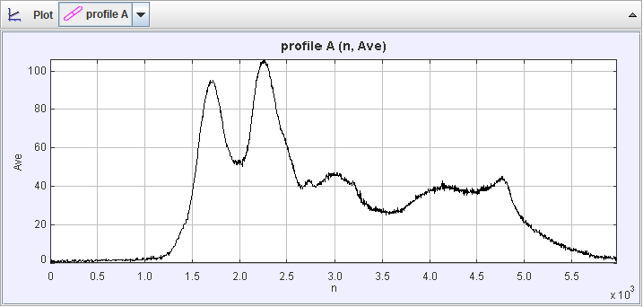
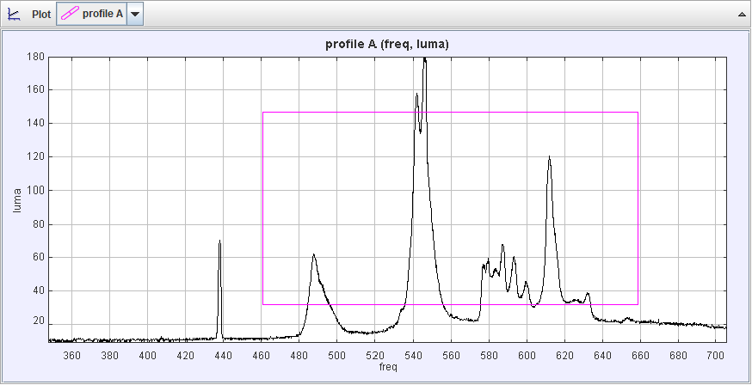
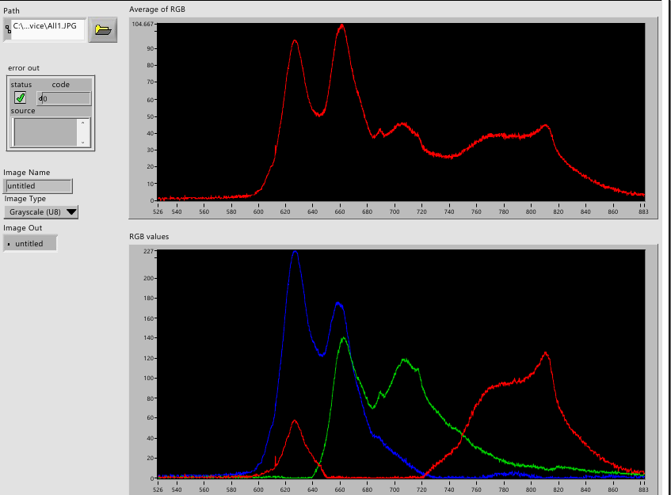
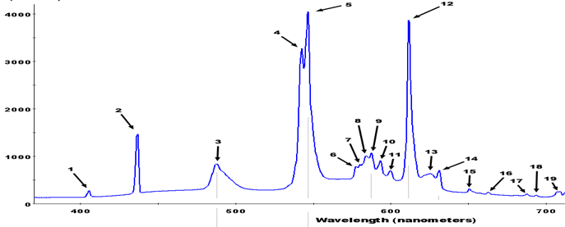
Results
Compact Fluorescent Lamp
Output of device when all LEDs are at full brightness
Notes:
Spectrometer extremely accurate
Automated image analysis also accurate (needs calibration)
Simulator very accurate

Slide 7
Evaluation
So far:
developed working hardware
Overcome a lack of access to equipment
Proven that the measurement method is robust
Developed an accurate simulation suite
Developed automation software to aid with recordings
Begun optimisation of output spectra
Notes:
the hardware is relatively simple,
the completion reflects the adaptability of the project management.
The current results not yet fit into the state-of-the art
Fills a gap in the market
Breadboard work as intended
Spectrometer and simulator are both accurate
confident will fit the requirements specification
and effectively prevent melatonin secretion

Slide 8

Next steps
What’s left:
Optimise device output spectra using simulator and measurements (ongoing)
Convert arbitrary intensity to $μW/{cm}^{2}/nm$ using lux measurements
Analyse melanopic effect of light
Verify that spectra can be faded between “realistically”
Notes:
The brightness of the device may be the only shortcoming – needs more LEDs

Slide 9
References
Czeisler, C. A. (2013). Perspective: casting light on sleep deficiency. Nature, 497(7450), S13-S13.
Grose, M. (2014). Artificial light at night: a neglected population health concern of the built environment. Health promotion journal of Australia: official journal of Australian Association of Health Promotion Professionals, 25(3), 193-195.
Lucas, R.J., Peirson, S.N., Berson, D.M., Brown, T.M., Cooper, H.M., Czeisler, C.A., Figueiro, M.G., Gamlin, P.D., Lockley, S.W., O’Hagan, J.B. and Price, L.L., (2014). Measuring and using light in the melanopsin age. Trends in neurosciences, 37(1), pp.1-9.

